Slide 1
Stage 2 Technical Report
Working title
Avoid prove, cause and effect
Should be informative
Introduction
Methodology
Report (each member takes 2 variables and completes an analysis)

Slide 2
Moving on: Stage 3
Turn in Stage 2:Due 4/26; Teams channel, title Stage 2.
In Conversation: State you have turned this in.
Final Report due: 5/7 (last day of classes)
1. Title Page
The title page should contain a title that helps the reader know what the report is about. In addition, the title page should contain:
names of the group members
your university
date submitted.

Slide 3
Following the Title Page
2. a. Abstract
Brief (one paragraph) description of the entire report
2. b. Table of Contents
List the titles of the sections and subsections with page numbers

Slide 4
Examples: Title and Abstract
Technical report. Legalization of marijuana: potential impact on youth.
This technical report provides historical perspectives and comparisons of various approaches to the legal status of marijuana to aid in forming public policy. Information on the impact that decriminalization and legalization of marijuana could have on adolescents, in addition to concerns surrounding medicinal use of marijuana, are also addressed in this report. Recommendations are included in the accompanying policy statement.

Slide 5
Is marijuana use associated with decreased use of prescription opioids? Toxicological findings from two US national samples of drivers.
Background: State governments in the United States are increasingly viewing marijuana legalization as a policy option for controlling the opioid epidemic under the premise that marijuana is a less harmful substitute for opioids. The purpose of this study is to assess whether marijuana use is associated with decreased odds of prescription opioid use.
Methods: A cross-sectional study design was applied to toxicological testing data from two national samples of drivers: 1) the 2011–2016 Fatality Analysis Reporting System (FARS) and 2) the 2013–2014 National Roadside Survey of Alcohol and Drug Use by Drivers (NRS). Adjusted odds ratios (ORs) and 95% confidence intervals (CIs) estimated from multivariable logistic regression models were used to assess the associations of marijuana use with prescription opioid use and alcohol use.
Results: Among the 47,602 drivers from the FARS, 15.7% tested positive for marijuana and 6.9% positive for prescription opioids. Compared with drivers testing negative for marijuana, those testing positive for marijuana were 28% more likely to test positive for prescription opioids (adjusted OR = 1.28, 95% CI = 1.15–1.42). Among the7881 drivers from the NRS, 7.9% tested positive for marijuana and 4.5% positive for prescription opioids. Relative to drivers testing negative for marijuana, those testing positive for marijuana were twice as likely to test positive for prescription opioids (adjusted OR = 2.03, 95% CI = 1.29–3.20). In both study samples, marijuana use was associated with significantly increased odds of alcohol positivity.
Conclusions: Drivers who test positive for marijuana are significantly more likely to test positive for prescription opioids. Longitudinal studies with rigorous designs and toxicological testing data are needed to further address the substitution hypothesis between marijuana and prescription opioids.
Keywords: Alcohol, Harm reduction, Marijuana, Prescription opioids, Substitution

Slide 6
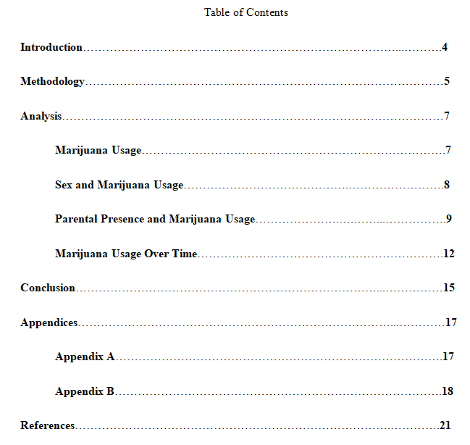
TOC: From Sample Technical Report (Blackboard)

Slide 7
Paper, divided into sections and subsections as indicated in TOC
Introduction
Methodology
Report/Analysis/Findings/Results
Discussion of your major findings, which hopefully are related to and can help answer your research questions. The “findings section” should be divided into subsections.
Suggestion: Start with your response variables (but no need to name them that!). Every section needs to begin with an introductory sentence – words!

Slide 8
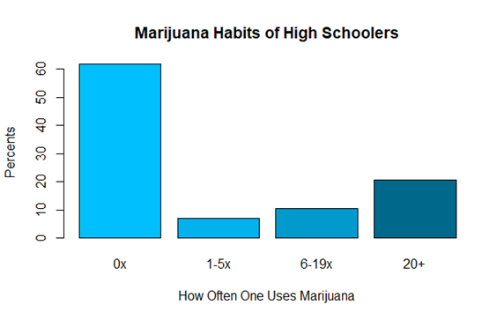
Suggested first paragraph for report section: Start with response variable(s)
Marijuana usage: maybe statement tying in with introduction.
Might be a good place for a time series
Analyze responses to MTF question on marijuana usage for 2018 data: table, bargraph, or pie chart. (One below didn’t have a figure # No-No!)
Might compare to 2017 data: show any change from previous year.
End with transition sentence(s) to subsection(s) that follow.

Slide 9
Add subsections – maybe one per explanatory variable
Subsection 1: Focus on the relationship between your response variable and one of your explanatory variables. Again, start with an introductory sentence guiding the reader – letting the reader know what this section will be about. (Here you should be essentially introducing one of your research questions – even if you don’t call it a research question.)
Example: Relationship Between Sex and Marijuana Usage
Results from chi-squared test: relationship is significant
If yes, explore the nature of the relationship: show an appropriate graphic display: bar chart representing the conditional distribution of the response variable for each level of the explanatory variable. Give this display a figure # and caption.
Describe the relationship you see in that display in words. Do not assume that the reader sees what you see! Point out patterns within a distribution or between the distributions for levels of the explanatory variable. Do not just list the percentages – help the reader see differences.

Slide 10
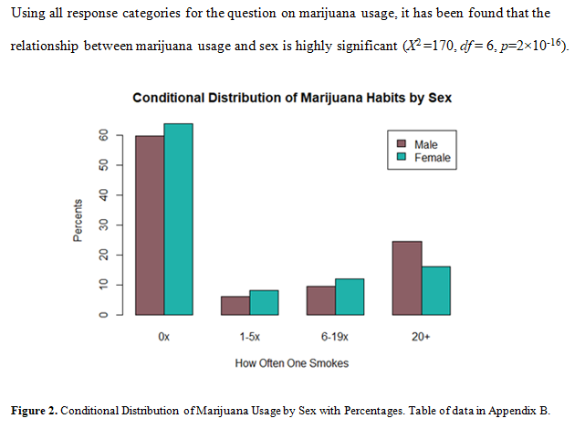
Example: Reporting Outcome of Chi-Square Test

Slide 11
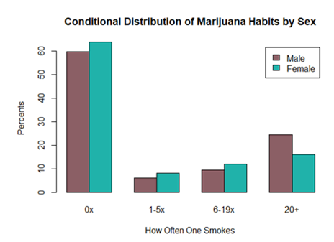

The bar plot in Figure 2 exemplifies the distribution of marijuana habits using percentages within the levels of sex. There are about 2% more females who smoke between 1-19 times than males; however, when looking at 20+ times of smoking, 8% more males answered yes than females. Missing: females more likely to be non-smokers than males.

Slide 12
You have completed your analysis: Now What?
Conclusion
Summary of your results.
Might connect your results up with research articles cited in your introduction.
Suggestions for further research.

Slide 13
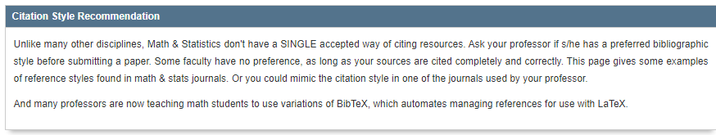
References (Use any reputable style)
https://guides.tricolib.brynmawr.edu/c.php?g=285071&p=1899518
MLA (Modern Language Association): https://owl.purdue.edu/owl/research_and_citation/mla_style/mla_formatting_and_style_guide/mla_formatting_and_style_guide.html

Slide 14
Last Thing: Appendix
Statement of survey questions from MTF Codebook. (This is a must!)
Tables supporting graphic displays that might be redundant if included in report. Tables or graphic displays that you decide not to use because relationships between variables were not significant.
Tables of counts (frequencies). This way the reader can “play” with the data.
Statement of formal research questions.
Anything you worked on for a long time but it didn’t make its way into the report for one reason or another and you want to show that work.

Slide 15
Technical Report Grade: __________________________
Group Members: _____________________________________________________
Comments related to the grading process follow. (Keep these in mind when writing the report.)
Writing Quality
Organization of ideas
Logical order
Descriptive section headings and subheadings
Language appropriate for statistical report
Mechanics—spelling, punctuation, grammar

Slide 16
Report Elements
Descriptive title and title page
Abstract and Table of Contents
Report
Introduction – clear statement of research question(s) addressed, importance/relevance of questions clearly expressed
Study design/methodology – discussion of MTF and data collection methods, discussion of statistical methods you plan to use
Description of findings
Written description
Numeric/graphical support
Thoroughness of analysis—one variable, more than one variable (relationships
between variables) .Answers to research questions posed or reason why
results are inconclusive. Time series for one variable, chi-square tests, bar
charts, etc.
Conclusion – wrap up your report.
References and Appendix

